Slide 1
IHG Email Campaign Predictive Results
Team:
Lodging Leaders
April 28, 2023

Slide 2



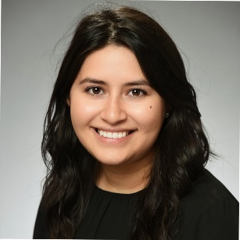
Team Introduction
McKaleb Harlemon
MS in Applied Statistics and Analytics
Graduating May ‘24
Sports Psychology
PLACEHOLDER
PLACEHOLDER
David Askew
MS in Information Systems
Graduating June ‘23
Hiking
Boating
Traveling
Nathaniel Jones
MS in Applied Statistics and Analytics
Graduating Dec ‘23
Movies
Mathematics
Digital Media Data
Maria Casas
MS in Applied Statistics and Analytics
Graduating May ‘23
Cooking
Painting
Home Improvement

Slide 3
Problem Overview

Slide 4
Problem Overview
General Problem
To accurately predict whether a member will click on a link in an email
Why It Matters
Better customer targeting
Understand which member demographic is more likely to click on an email link
Select email recipients by specific member behavior
Notes:
KH

Slide 5
Approach
Goal: Create a usable model that accurately predicts member click behavior
We aim to answer questions like the ones below for each category.
Hotel Stay History
When was the last stay?
Average stay length?
Total revenue?
Email History
When was the last click?
Total emails received?
Click rate?
Member Details
Program tenure?
Member tier?
Income group?
Notes:
KH

Slide 6
Data Preprocessing &
Feature Engineering

Slide 7
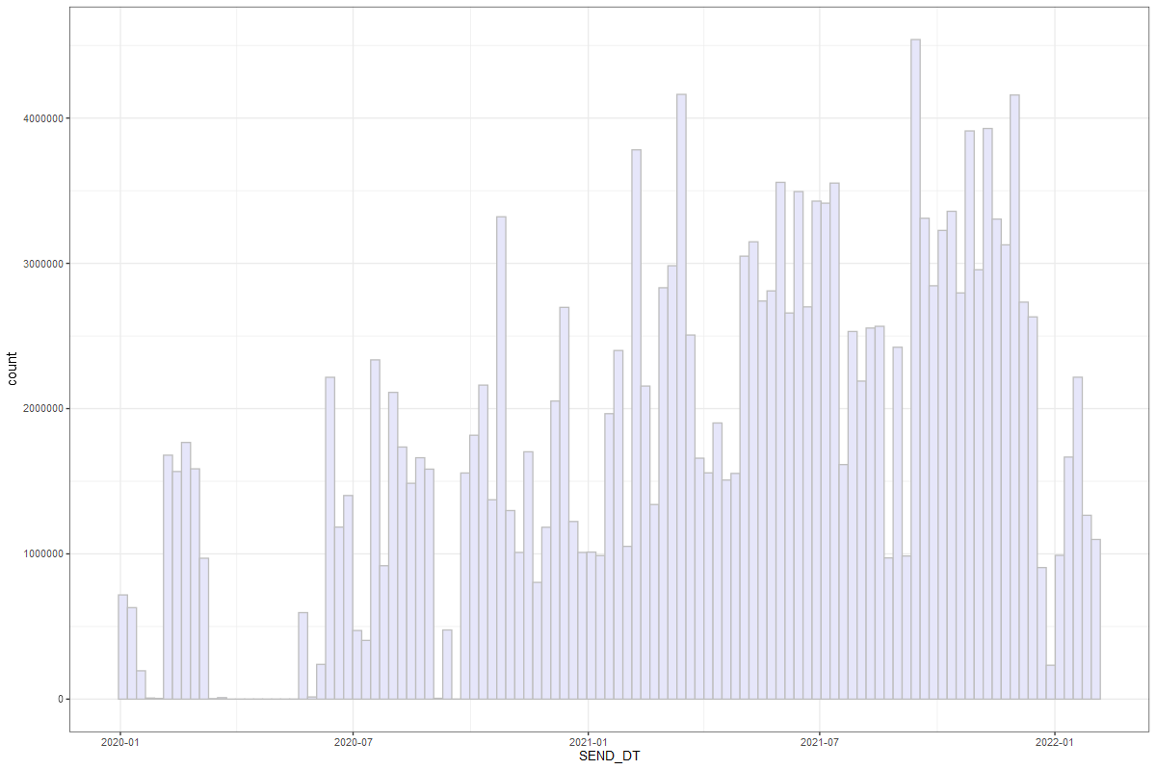
Data Process
Important Details
192 million emails
(1/1/20 - 1/31/22)
Low frequency in 2020
Training Set
Emails sent between (01/01/21 - 01/31/22)
Volume of Emails Sent over Time
4 million
3 million
2 million
1 million
0
Jan 2020
Jan 2021
Jan 2022
Email Send Date
Notes:
N

Slide 8
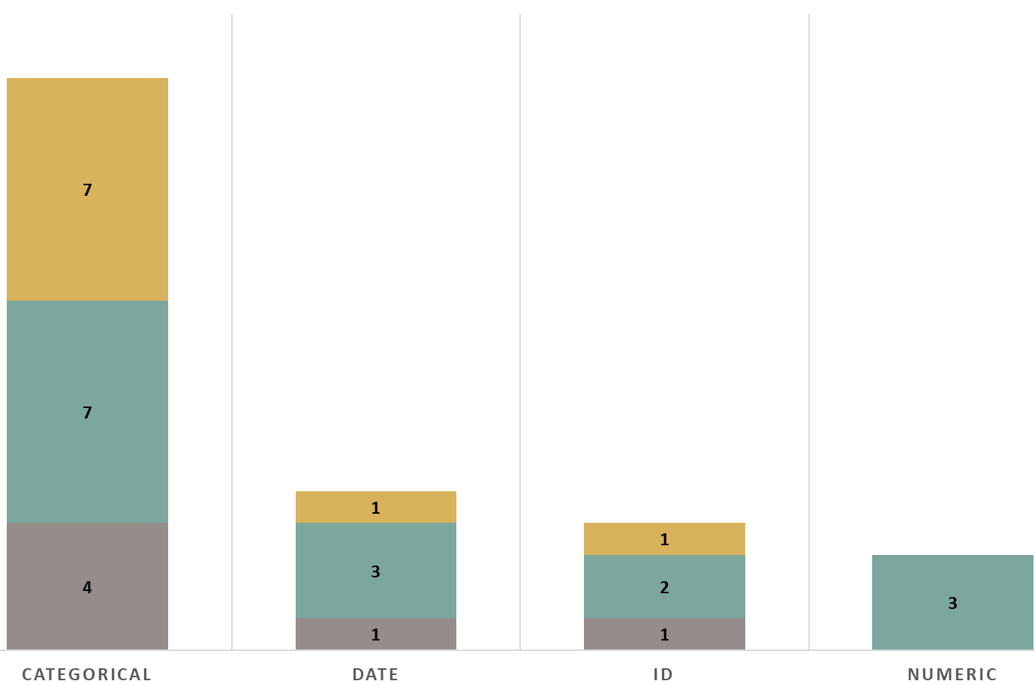
Data Wrangling
Data Given
7 Email Variables
15 Hotel Stay Variables
9 Members Variables
Data Engineered
298 Engineered Variables
Volume of Data Types in the Given Dataset
18
5
4
3
Notes:
N

Slide 9
Approach for Feature Engineering
Goal: Engineer variables that maximize the performance in predicting clicks
Recency
How recently has a member received/clicked an email or stayed at a hotel?
Frequency
How many hotel stays or emails has the member received/clicked?
Monetary Value
How much time or money has a member spent?
Notes:
DA-

Slide 10
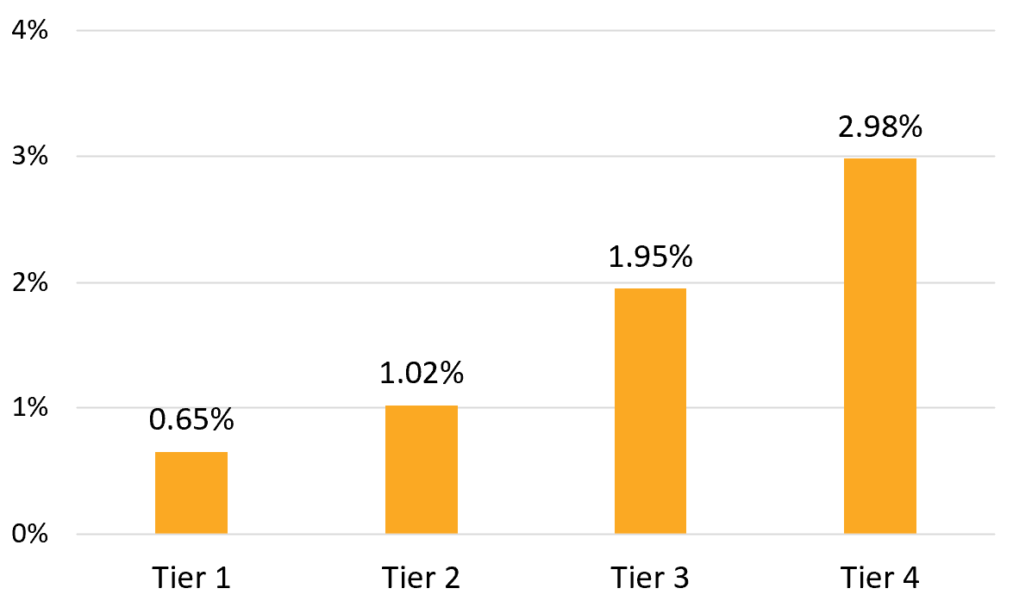
Feature Engineering
Demographics
4 variables
Click Rate by Member Tier
4%
3%
3.0%
Members
2.0%
2%
1.0%
Enrollment in Reward Program
4 variables
1%
0.7%
0%
Tier 1
Tier 2
Tier 3
Tier 4

Slide 11
Feature Engineering
Days Since Last Email
Days Since Last Click
Days to Nearest Holiday
Recency
Days Since Recent Hotel Stay
Current Hotel Stay Indicator
90-Day Click Rate by Member
Recent Member Tier Change
Notes:
DAYS Since last click. This is important because if they have clicked recently there is a higher likelihood that they will click again.

Slide 12
Feature Engineering
By Email Campaign
By Month
By Membership Tier
By Day of Week
By Lifecycle Code
Emails Prior
Clicks Prior
Frequency
Hotel Stays
Unique Regions Visited
Unique Hotels Booked
Campaign Click-through Rate
Notes:
Focus on Email Campaign because this is important to understand their future behavior.

Slide 13
Feature Engineering
Emails Prior
By Email Campaign
By Month
By Membership Tier
By Day of Week
By Lifecycle Code
Clicks Prior
Frequency
Hotel Stays
Unique Regions Visited
Unique Hotels Booked
Campaign Click-through Rate
Notes:
Click rate is important to our model interpreting the data.

Slide 14
Feature Engineering
Emails Prior
Clicks Prior
By Business/Leisure Indicator
By Different Continent Indicator
By Hotel Chain
By Hotel Chain Category
By Reward Night
Frequency
Hotel Stays
Unique Regions Visited
Unique Hotels Booked
Campaign Click-through Rate

Slide 15
Feature Engineering
Average Hotel Stay Revenue
Average Hotel Stay Revenue per Room
Total Hotel Stay Revenue
Monetary Value
Average Booking to Check-In Interval
Proportion on Stays Paid by Points/Rewards
Proportion of Stays by Business/Leisure
Average Booking Duration

Slide 16
Feature Engineering
Member Variables
Email History Variables
Stay History Variables
Enrollment in Reward Program
Enrollment channel
Rewards program tenure
Member tier
Member lifecycle
Member/Email Interaction
Total emails sent
Days since last email
Days since last click
Total clicks
Click rate
Unsubscribe indicator
Stay History
Total stays
Total rooms booked
Total nights stayed
Days since last stay
Average nights per stay
Demographics
Age group
Gender
Income group
Member subregion
Stay Tendencies
Proportion of stays by business/leisure
Proportion of stays by hotel chain category
Average guests per stay
Avg days between confirmation and check-in
Email Campaign Details
Campaign type of email sent
Number of campaign types received
Click rate by campaign type
Seasonal Variables based on Send Date
Days since last holiday
Days until next holiday
Seasonal indicator
Day of the week
Day of the month
Revenue and Rewards
Average revenue per stay
Total revenue
Days since last points/rewards stay
Proportion of stays paid by points/rewards

Slide 17
Feature Selection

Slide 18
Feature Selection
Chi-Square test compares the observed and expected frequency of click
Identifies attributes that are highly associated with click
Top three attributes
Clicked in the last 60 days
Member Click Rate
Days Since Last Click
Chi-Square Test Statistics
* Top 15 Variables
Notes:
In order to select the best features from the 300 we created; we used a Chi-Square test.
The Chi-Square test can be applied to compare the observed frequency of clicks across an attributes range to the expected frequency.
As a result, we receive a difference in what we observe and what we expect for each email attribute, and we can compare these differences.
This information is valuable for a marketing team because it can help identify which email attributes are more highly associated with click by identifying the attributes with the largest
At the bottom of this plot, the first 4 variables are indicators for whether a member clicked an email or not within a certain amount of days.
For example, the attribute 'Clicked within 30 days' has the highest chi-square score which suggests this attribute is highly associated with whether they will click on the current email sent.
This attribute is a one (1) if the member clicked within 30 days prior to the current email send date and a zero (0) for any other case.
Since a member that clicks within 30 days has also clicked within 60, 90, 180 days, all four of these attributes are related to each other.
If we included all four of these attributes, then our model may produce unreliable estimations.
To keep this from happening, we selected one as a representative in a model and excluded the rest.
From here we saw three clear winners: CLICKED_WTHN_60_DAYS, member click rate, & Days since last click.
We created an exhaustive list of possible variable combinations and created models to test the performs of each list.

Slide 19
Feature Selection
The Variance Inflation Factors (VIF) indicates multicollinearity is not an issue.
Our final set of input variables includes 57 variables in total:
Member Click Rate
Days Since Last Click
Clicked in Last 60 Days
Member Demographic Variables
Email Demographic Variables
Variance Inflation Factors (VIF)
Member Click Rate | 1.27
Days Since Last Click | 1.35
Clicked Within 60 Days | 1.48

Slide 20
Models

Slide 21

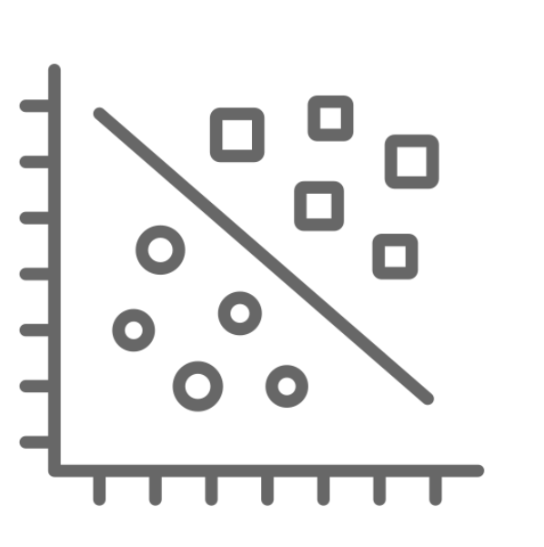
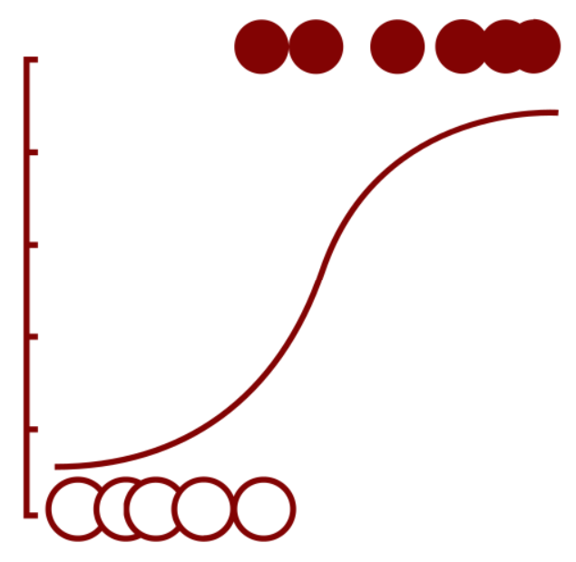

Models Used
ORIGINAL SLIDE
Decision Tree | Naïve Bayes | Logistic Regression | Gradient-Boosted Trees (XGBoost)
Simple and interpretable structure Easily captures complex interactions | Based on conditional probability Computationally efficient | Robust to noise and outliers in the data Provides a probability value for clicking | Single decision tree output Retrains to ‘fix’ incorrect predictions

Slide 22
Models Used
Nate’s Attempt
Decision Tree | Naïve Bayes | Logistic Regression | Gradient-Boosted Trees (XGBoost)
Simple Interpretable Adaptable | Probability based Computationally efficient Robust | Estimated probability Reliable Interpretable | Multiple Decision Trees Scalable Robust

Slide 23
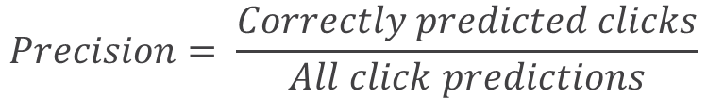
Comparison Metrics
Precision
Represents the clicks correctly predicted over the total number of predictions
Higher is better ⬆
Model | Precision
XGBoost | 0.11
Naïve Bayes | 0.15
Decision Tree | 0.73
Logistic Regression | 0.82
$$Precision= \frac{Correctly predicted clicks}{All click predictions}$$

Slide 24
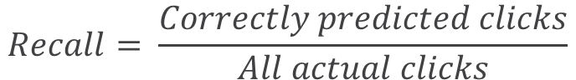
Comparison Metrics
Recall
Percentage of actual clicks that are correctly predicted by models
Higher is better ⬆
Model | Recall
XGBoost | 0.89
Naïve Bayes | 0.73
Decision Tree | 0.24
Logistic Regression | 0.14
$$Recall= \frac{Correctly predicted clicks}{All actual clicks}$$

Slide 25
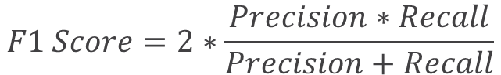
Comparison Metrics
F1-Score
Combines precision and recall of the model and allows for a single measure to accounts for these ideas
Higher is better ⬆
Model | Recall
XGBoost | 0.20
Naïve Bayes | 0.25
Decision Tree | 0.36
Logistic Regression | 0.24
$$F1 Score=2∗\frac{Precision∗Recall}{Precision+Recall}$$

Slide 26
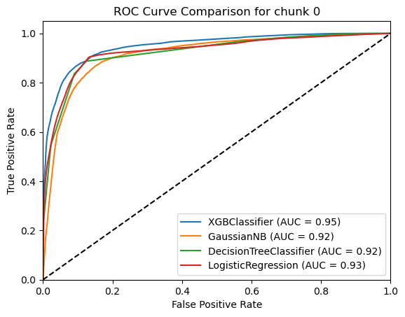
Comparison Metrics
Area Under Curve (AUC)
Measure of how much models are capable of distinguishing between a click and no click
Higher is better ⬆
Model | AUC
XGBoost | 0.95
Naïve Bayes | 0.92
Decision Tree | 0.92
Logistic Regression | 0.93

Slide 27
Model Comparison
 | Predicted |  |  | Predicted |  |  | Predicted
Actual | Click | No Click |  | Click | No Click |  | Click | No Click
 | XGBoost |  |  | Decision Tree |  |  | Naïve Bayes
Click | 1.6% True Positives | 0.2% False Negatives |  | 0.4% True Positives | 1.3% False Negatives |  | 1.3% True Positives | 0.5% False Negatives
No Click | 12% False Positives | 86% True Negatives |  | 0.2% False Positives | 98% True Negatives |  | 7% False Positives | 91% True Negatives
All three models performed comparatively well
If the goal is to minimize false negatives (predicted not to click, but member did click), the XGBoost model is our recommended model
If the goal is to balance false predictions (predicted to click, but member did not click), the Naïve Bayes model is our recommended model

Slide 28
Important Variables
Identified by XGBoost Only
Important Variables Identified by Both Models
Identified by Naive Bayes Only
Member Income Group
Member Enroll Channel
Days Since Last Click
Member Click Rate
Email Send Date (ex: day of week, month)
Member Age Group
Campaign Category
Member Lifecycle
Member Tier
Clicked in Last 60 Days
Member Gender

Slide 29
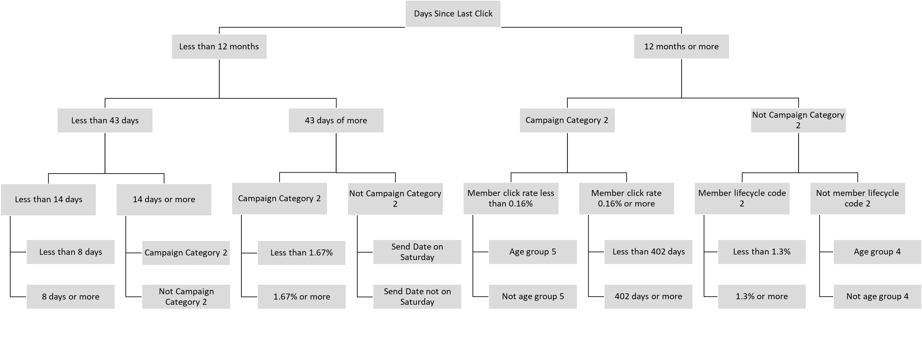
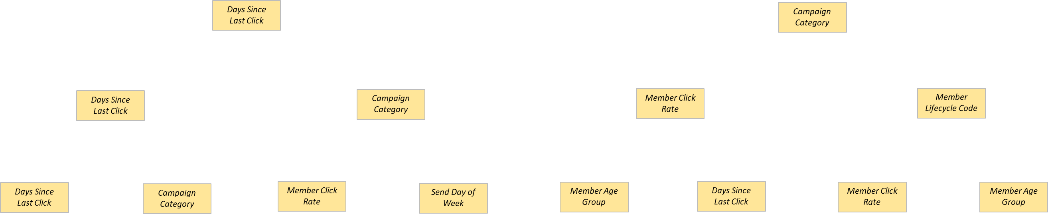
Recommended Model: XGBoost Tree
To minimize the opportunity cost, the recommended model is the gradient boosted decision tree

Slide 30
Insights from XGBoost Tree
Days Since Last Click
Less than 12 months
Less than 43 days
43 days or more
Campaign category 2
Not campaign category 2
Send Date not on Saturday
Send Date on Saturday
Less than 1.67%
1.67% or more
Less than 14 days
14 days or more
Campaign category 2
Not campaign category 2
Less than 8 days
8 days or more
Days Since Last Click
By further analyzing the tree, insights like these can be uncovered:
Less than 12 months
...
Members who clicked within the last year...
Days Since Last Click
But, clicked more than 43 days ago
43 days or more
AND received the email from a campaign category other than 2
Days Since Last Click
Campaign Category
AND received the email on a day other than Saturday
Not campaign category 2
These make up 6% emails sent in January 2022, yet yield 28% of all the clicks in that same time frame
Days Since Last Click
Campaign Category
Member Click Rate
Send Day of the Week
Send date not on Saturday
Notes: Validation set was January 2022.
Notes:
This model works like a data flowchart where the ‘nodes’ are our decisions, whether the member is in tier 1 or tier 2.
Its level based, so decisions made after one node does not apply to any other node on level.
This can limit the accuracy of the estimation because each conditional decision will have to be branched out.

Slide 31
Final Recommendations
IHG can chose the model that best fits the goal
XGBoost to minimize false negatives
Naïve Bayes to balance false predictions
Trees from XGBoost model are best for interpretability
Insights like in the previous slide can be used to target audiences with better relative return on investment

Slide 32
Thank you! Questions?

Slide 33
Appendix

Slide 34
Appendix Table of Contents
Project Assumptions and Objectives...................................................25 - 28
Data Process........................................................................................29 - 34
Data Discovery and Feature Engineering............................................35 - 39
Models and Dashboard......................................................................40 - 42

Slide 35
Project Understanding and Objectives

Slide 36
Understanding of the Data
If an email marketing link was clicked (CLICK = 1),
Then a member clicked on either an
Offer page or Non-offer page
Unsubscribed
If an email marketing link was not clicked (CLICK = 0),
Then the email may have been opened, but no way to confirm
Cancelled stays are not included in the stay history dataset
All confirmation dates have a check-in and check-out date
Notes:
MK-1.5 Minutes

Slide 37
Approach
Goals
Build out time frame for training dataset and stay/email history
Engineer feature variables for input datasets
Assess quality and usefulness of variables
Build classification models for prediction
Compare model performances
Recommend best model
Notes:
MK-1.5 Minutes
The models we are focusing on building will be a decision tree model [CLICK] and a naïve bayes model. [CLICK]
Building these models will allow us to compare the different algorithmic approaches on the data. [CLICK]
In addition to that the decision tree model requires very littler data preparation and [CLICK] is not effected by missing or extreme values.
This model also handles our [CLICK] class imbalance issue, but could be very slow to train depending on the number of rows and columns used. [CLICK]
On the other hand, the naïve bayes model is fast and can provide real-time predictions. [CLICK]
This model also works really well with a high number of categorical columns, like the data we have. [CLICK]
It can also outperform a decision tree model and be used to generatively produce likelihoods. [CLICK]
Mention performance metrics that we will use

Slide 38
Problem Overview
General Problem
To accurately predict whether a member will click on a link in an email
Why It Matters
IHG can be better equipped to understand who is more likely to click links in their emails
Our analysis can generate a better understanding of rewards member base that will allow IHG to better select optimal audiences for email campaigns
Notes:
MK-1.5 Minutes
As a review of the objective of this project, we are working to predict whether a rewards member will click on an email link.
The fact that this is predictive question guides our approach in attempting to answer it.
We believe that by answering this question we can help IHG understand who is more likely to click and they will be better equipped to select the best audiences for their email campaigns.

Slide 39
Project Understanding and Objectives

Slide 40
Data Merge
Hotel Stay
Group By Member ID, then List
Historic Cohort
No
Email
Is 45 days before 1/31/22
Index Lists Relative to Email Send Date
Yes
Join by Member ID
Model Cohort
Members

Slide 41
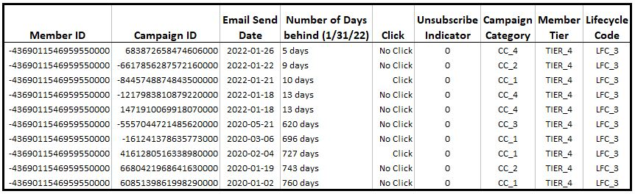
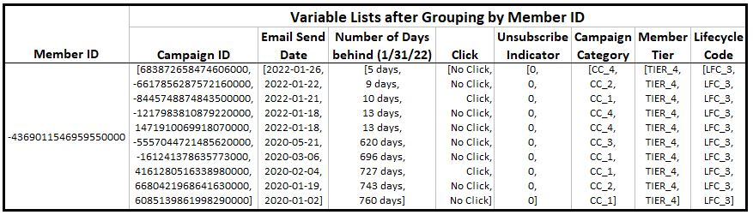
Data Merge Example
Slice of a Member’s History
Grouped by Member ID

Slide 42
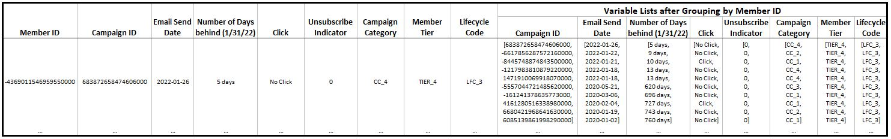
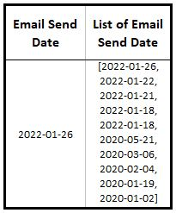
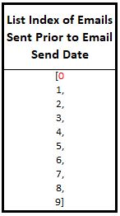
Data Merge Example
Join Lists Back into Model Cohort

Slide 43
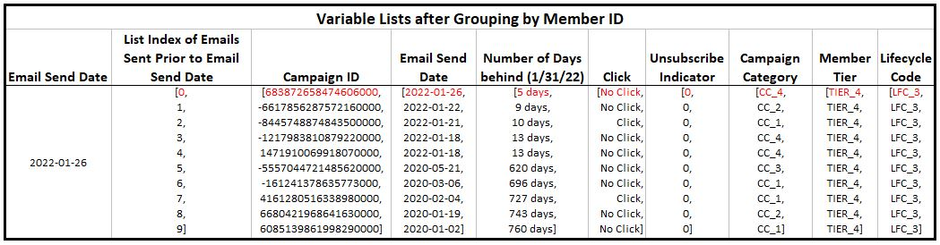
Data Merge Example
Full Index List

Slide 44
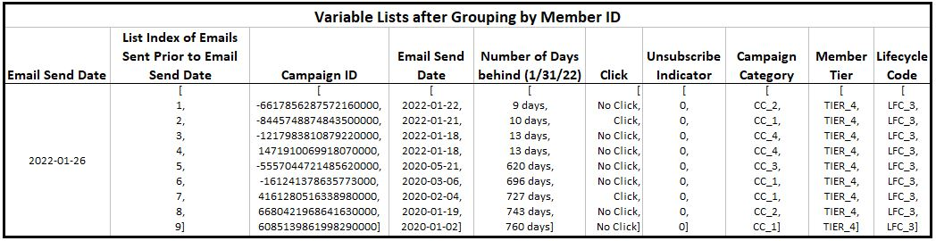
Data Merge Example
Index List After Removal

Slide 45
Data Discovery and Feature Engineering

Slide 46
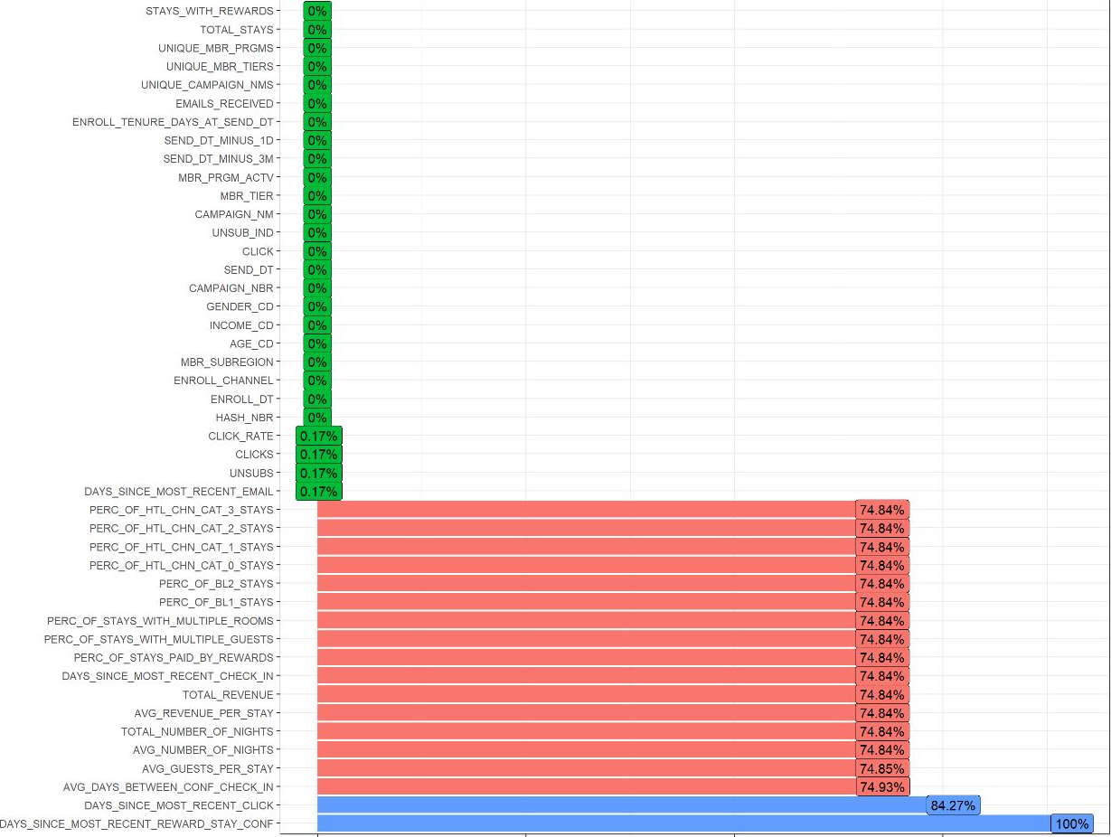
Percent of Rows Missing a Value by Variable

Slide 47
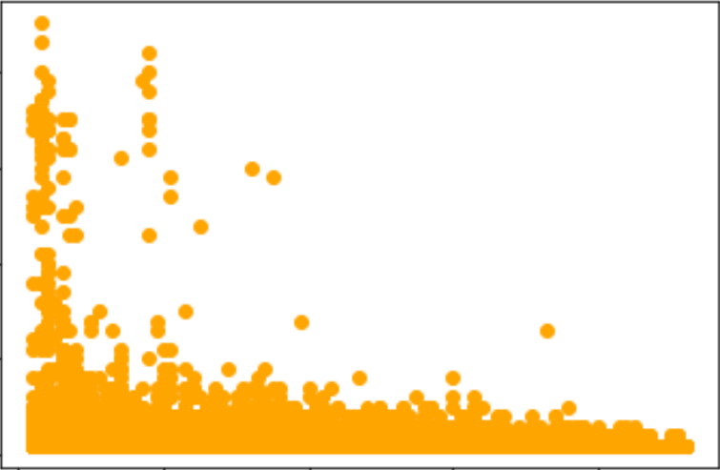
Inferences from Visuals
Graphing feature variables with target to get a sense of the directionality, strength of relationship and predicting power
Bar Chart: Click Rate by Member Tier
Scatterplot: Clicks vs Days Since Last Click
4%
40
2.98%
3%
30
1.95%
2%
Clicks
20
1.02%
1%
0.65%
10
0%
0
Tier 1
Tier 2
Tier 3
Tier 4
0
30
60
90
Days Since Last Click

Slide 48
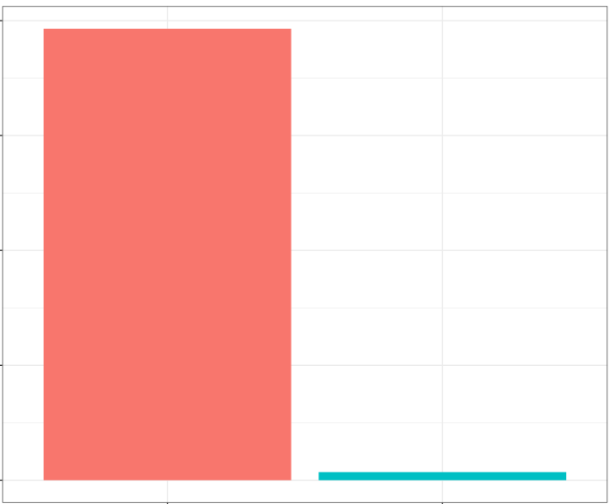
Percent of Click/No Click in the 1-month Dataset
100%
75%
50%
25%
98.2%
1.76%
0%
No Click
Click

Slide 49
Feature Engineering
Member Email/Interaction
6
Income Group
Email History Variables
Email Campaign Details
3
Distinct Number of Campaign Types Received
Seasonal Variables based on Send Date
5
…
Notes:
DA-1.5-
Mention Reward Program Tenure as we had to develop that. >additionally-> tenure is important because a recent member might be on the look out for emails to get an idea of what the rewards program offers; Demographics: mention how we chose to exclude member city and state because of the large number of missing values and unique values. the Member/email interaction: mention Click Rate and how although it may seem obvious, we want to predict a click by using historical tendency to click as a predictor; Email campaign details: distinct number of campaign types received – point to drive here is that by know how many types of campaigns get send to a particular member, we can get an idea of the variety of campaigns they are targeted with Seasonal variables: Not just the stay and email interaction can explain a click – we want to include variables related to when the member gets an email because proximity to a travel holiday or day of the month they get the email could help us predict. Stay history: Something like the recency of a stay or whether or not they stayed, we hope can help predict. Stay tendencies: the hotel chain a member frequents can educate us in what emails they are more likely to click. Revenue and rewards: a member’s engagement with the rewards program by looking at the frequency of stays paid for by points and rewards could show a member that might be eager to receive more promotions and therefore click

Slide 50
Models and Dashboard

Slide 51
Feature Engineering
Member Variables
Email History Variables
Stay History Variables
Enrollment in Reward Program
Enrollment channel
Rewards program tenure
Member tier
Member lifecycle
Member/Email Interaction
Total emails sent
Days since last email
Days since last click
Total clicks
Click rate
Unsubscribe indicator
Stay History
Total stays
Total rooms booked
Total nights stayed
Days since last stay
Average nights per stay
Demographics
Age group
Gender
Income group
Member subregion
Stay Tendencies
Proportion of stays by business/leisure
Proportion on stays paid by hotel chain cat.
Average guests per stay
Avg days between confirmation and check-in
Email Campaign Details
Campaign type of email sent
Number of campaign types received
Click rate by campaign type
Seasonal Variables based on Send Date
Days since last holiday
Days until next holiday
Seasonal indicator
Day of the week
Day of the month
Revenue and Rewards
Average revenue per stay
Total revenue
Days since last points/rewards stay
Proportion on stays paid by points/rewards
Notes:
DA-1.5-
Mention Reward Program Tenure as we had to develop that. >additionally-> tenure is important because a recent member might be on the look out for emails to get an idea of what the rewards program offers; Demographics: mention how we chose to exclude member city and state because of the large number of missing values and unique values. the Member/email interaction: mention Click Rate and how although it may seem obvious, we want to predict a click by using historical tendency to click as a predictor; Email campaign details: distinct number of campaign types received – point to drive here is that by know how many types of campaigns get send to a particular member, we can get an idea of the variety of campaigns they are targeted with Seasonal variables: Not just the stay and email interaction can explain a click – we want to include variables related to when the member gets an email because proximity to a travel holiday or day of the month they get the email could help us predict. Stay history: Something like the recency of a stay or whether or not they stayed, we hope can help predict. Stay tendencies: the hotel chain a member frequents can educate us in what emails they are more likely to click. Revenue and rewards: a member’s engagement with the rewards program by looking at the frequency of stays paid for by points and rewards could show a member that might be eager to receive more promotions and therefore click

Slide 52
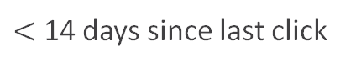
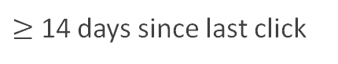
Recommended Model: If Naïve Bayes
Determined Probability
Condition Based Output
Fast
Condition
Click
No Click
Example
Click
No Click
Campaign Category 1
15 %
85 %
15 %
85 %
Campaign Category 2
7 %
93 %
Campaign Category 3
48 %
52 %
Campaign Category 4
63 %
37 %
$<$ 14 days since last click
78 %
22 %
78 %
22 %
$≥$ 14 days since last click
23 %
77 %
No Click History
8 %
92 %
…
…
…
…
…
…
Email Click-Through > 5 %
82 %
18 %
82 %
18 %
Notes: Percentages indicate Probability of click. Actual results TBD.
Notes:
$$P\left(conditions | Click\right)=\frac{P\left(Click | conditions\right)∗P(conditions)}{P(Click)}$$

Slide 53
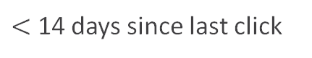
Recommended Model: If Naïve Bayes
Condition
Click
No Click
Example
Click
No Click
Condition Based Output
Determined Probability
Fast
Campaign Category 1
15 %
85 %
15 %
85 %
Campaign Category 2
7 %
93 %
Campaign Category 3
48 %
52 %
Campaign Category 4
63 %
37 %
$<$ 14 days since last click
78 %
22 %
78 %
22 %
$≥$ 14 days since last click
23 %
77 %
No Click History
8 %
92 %
…
…
…
…
…
…
Email Click-Through > 5 %
82 %
18 %
82 %
18 %
Notes: Percentages indicate Probability of click. Actual results TBD.
Notes:
$$P\left(conditions | Click\right)=\frac{P\left(Click | conditions\right)∗P(conditions)}{P(Click)}$$

Slide 54
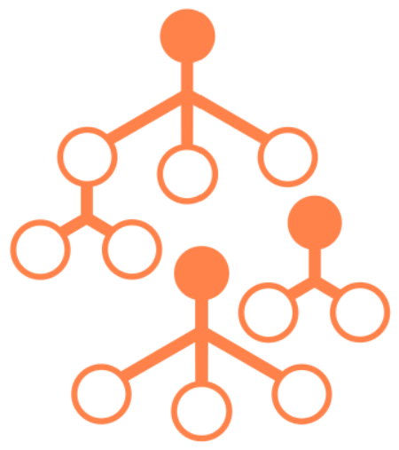
Models Used
Decision Tree | Random Forests | Naïve Bayes | Logistic Regression | Gradient-Boosted Trees (XGBoost)
Simple and interpretable structure Easily captures complex interactions | Series of semi-random decision trees Predictions averaged across trees | Based on conditional probability Computationally efficient | Robust to noise and outliers in the data Provides actual probabilities of success (clicking) | Single decision tree output Retrains to ‘fix’ incorrect predictions

Slide 55
Interactive Dashboard

Slide 56
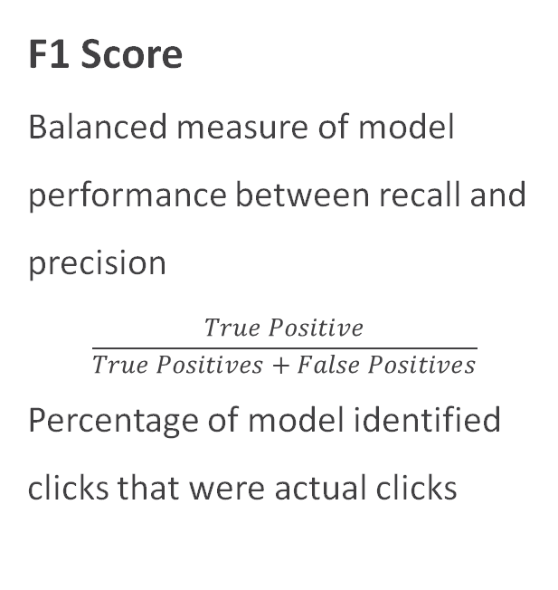
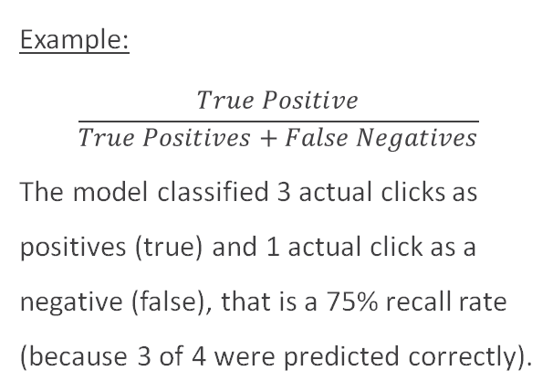
Comparison Metrics
Recall
Percentage of actual clicks that are correctly predicted by models
F1 Score
Balanced measure of model performance between recall and precision
$$\frac{True Positive}{True Positives+False Positives}$$
Percentage of model identified clicks that were actual clicks
ROC Index
Measure of how much models are capable of distinguishing between a click and no click
Example:
$$\frac{True Positive}{True Positives+False Negatives}$$
The model classified 3 actual clicks as positives (true) and 1 actual click as a negative (false), that is a 75% recall rate (because 3 of 4 were predicted correctly).
Notes:
Recall measures the percentage of actual clicks our model was able to predict correctly
ROC is an area under the curve measure that tells us how much the models are capable of distinguishing between a click or no click.
Both work well with imbalanced data sets like the one we are working with due to the 1% average click rate
#############################################################################################################
#############################################################################################################
Our model returns the probability that a member with given attributes will click vs not click.
We can measure the reliability of our model by many measures such as precision, recall, and an f1_score.
Precision accounts for the percentage of members the model correctly identitfies out of all members the model predicted to click.
On the other hand, recall measures the percentage of members the model correctly identitfies out of all members that clicked.
The f1_score combines the precision and recall of the model and allows for a single measure to accounts for these ideas.

Slide 57
Models Used
Decision Tree | Random Forests | Naïve Bayes | Logistic Regression | Gradient-Boosted Trees (XGBoost)
Simple and interpretable structure Easily captures complex interactions | Series of semi-random decision trees Predictions averaged across trees | Based on conditional probability Computationally efficient | Robust to noise and outliers in the data Provides actual probabilities of success (clicking) | Single decision tree output Retrains to ‘fix’ incorrect predictions

Slide 58
Models Used
ORIGINAL SLIDE
Decision Trees
Simple and interpretable structure
Easily captures complex interactions
Naïve Bayes
Based on conditional probability
Computationally efficient
Robust models that work well with
Categorical data
Missing data

Slide 59
Important Variables
ORIGINAL SLIDE
Identified by Decision Tree Only
Important Variables Identified by Both Models
Identified by Naive Bayes Only
Total Clicks in 90 Days before Email
Campaign Type
Days Since Most Recent Click
Click Rate in 90 Days before Email
Business/Leisure Stays Proportion
Member Program Tenure at Email Date
Days Until Next Holiday at Email Date
Member Tier at Email Date
Days Since Most Recent Check-In

Slide 60
Model Comparison
ORIGINAL SLIDE
Decision Tree
Naïve Bayes
 | Actuals
Predicted | Click | No Click
Click | 1630 True Positives | 150 False Positives
No Click | 140 False Negatives | 98,080 True Negatives
 | Actuals
Predicted | Click | No Click
Click | 1,150 True Positives | 95 False Positives
No Click | 145 False Negatives | 98,620 True Negatives
92.1% capture rate (recall)
93.1% area under curve (AUC) measure
89.4% capture rate (recall)
88.2% area under curve (AUC) measure
Notes:
Recall measures the percentage of actual clicks our model was able to predict correctly
ROC is an area under the curve measure that tells us how much the models are capable of distinguishing between a click or no click.
Both work well with imbalanced data sets like the one we are working with due to the 1% average click rate

Slide 61
Feature Selection
['CLICK_THROUGH_RATE', 'DAYS_SINCE_LAST_CLICK', 'CLICKED_WTHN_60_DAYS', 'January', 'February', 'April', 'May', 'June', 'July', 'August', 'September', 'October', 'November', 'December', 'Monday', 'Tuesday', 'Wednesday', 'Thursday', 'Friday', 'Saturday', 'Fall', 'Summer', 'Winter', 'week_of_year', 'day_of_month', 'day_of_year', 'is_end_month', 'is_start_month', 'is_end_quarter', 'is_start_quarter', 'MBR_PRGM_ACTV', 'CC_2', 'CC_3', 'CC_4', 'TIER_2', 'TIER_3', 'TIER_4', 'quarter_1', 'quarter_3', 'quarter_4', 'GNDR_1', 'GNDR_2', 'EN_1', 'EN_2', 'EN_3', 'EN_4', 'EN_6', 'AGE_1', 'AGE_2', 'AGE_3', 'AGE_4', 'AGE_5', 'INCOME_1', 'INCOME_2', 'INCOME_3', 'INCOME_4', 'INCOME_5']

Slide 62
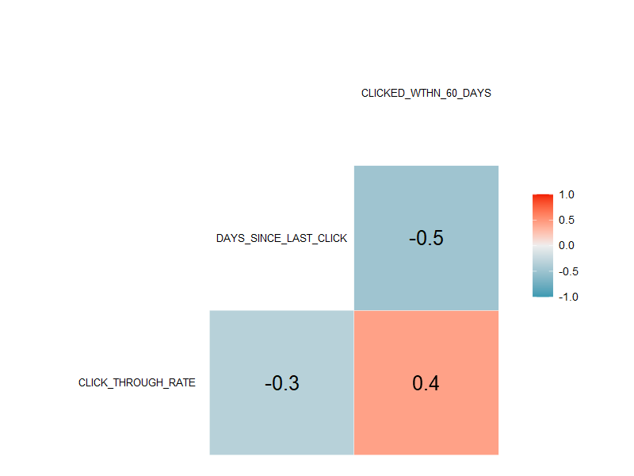
Feature Selection
Click Through Rate, Days Since Last Click, and Clicked within 60 days are moderately correlated
The Variance Inflation Factors indicates multicollinearity is not an issue.

Slide 63
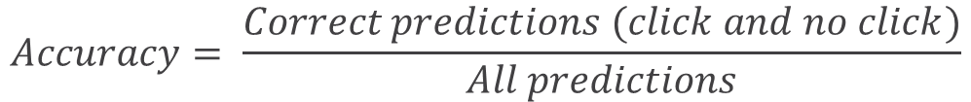
Comparison Metrics
Accuracy
Represents the number of correct predictions over the total number of predictions
Higher is better ⬆
Model | Accuracy
XGBoost | 0.88
Naïve Bayes | 0.92
Decision Tree | 0.99
Logistic Regression | 0.98
$$Accuracy= \frac{Correct predictions (click and no click)}{All predictions}$$

Slide 64
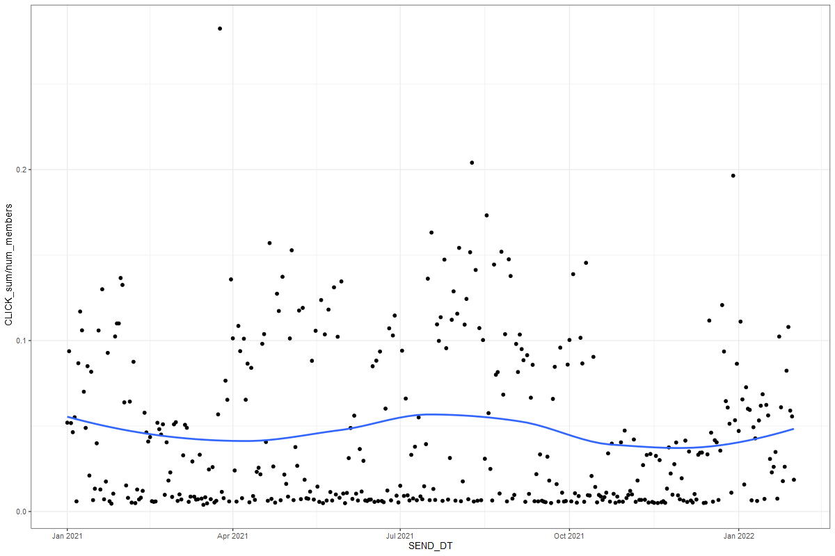
Data Process
ORIGINAL SLIDE
Click-Through Rate
Overall: 7%
Modeling Cohort
Most recent 45 days
(12/17/21 - 1/31/22)
Daily Click-Through Rate
Modeling Cohort
25 %
20 %
Historical Data
15 %
10 %
5 %
0 %
Jan 2021
Apr 2021
Jul 2021
Oct 2021
Jan 2022
Email Send Date
Notes:
N

Slide 65
Data Process
Click-Through Rate
Overall: 7%
Training Set
Emails with send date in 2021 (01/01/21 - 12/31/21)
Daily Click-Through Rate
Modeling Cohort
25 %
20 %
Historical Data
15 %
10 %
5 %
0 %
Jan 2021
Apr 2021
Jul 2021
Oct 2021
Jan 2022
Email Send Date
Notes:
N

Slide 66
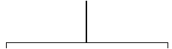
Full XGBoost Tree
Member Click Rate
Less than 69%
69% of more
Age group 4
Not age group 4
Age group 5
Not age group 5
Age group 3
Not age group 3
Less than 0.4%
0.4% or more
Less than 1.2%
1.2% or more
Less than 12.5 months
12.5 months or more
Less than 13 months
13 months or more
Less than 12 months
12 months or more
Less than 40 days
40 days or more
Less than 8 days
8 days or more
Campaign category 2
Not campaign category 2
Days Since Last Click
Age Group
Member Click Rate
Age Group
Days Since Last Click
Days Since Last Click
Days Since Last Click
Member Click Rate
Age Group
Days Since Last Click
Campaign Category
49.9%
50.0%
49.9%
50.0%
49.8%
49.8%
50.0%
50.1%
50.0%
50.0%
49.8%
50.0%

Slide 67
Data Process
ORIGINAL SLIDE
Emails
192 million emails
(1/1/20 - 1/31/22)
Important Details
Low frequency in 2020
2020 data was removed
Frequency of Emails Sent over Time
4 million
3 million
2 million
1 million
0
Jan 2020
Jan 2021
Jan 2022
Email Send Date
Notes:
N

Slide 68
Feature Selection
ORIGINAL SLIDE
Chi-Square test compares the frequency of clicks across an attributes range to the expected frequency of click.
This test can identify which email attributes are more highly associated with click.
Top Three Attributes
Clicked in the last 60 days
Member Click Rate
Days Since Last Click
Notes:
In order to select the best features from the 300 we created; we used a Chi-Square test.
The Chi-Square test can be applied to compare the observed frequency of clicks across an attributes range to the expected frequency.
As a result, we receive a difference in what we observe and what we expect for each email attribute, and we can compare these differences.
This information is valuable for a marketing team because it can help identify which email attributes are more highly associated with click by identifying the attributes with the largest difference.

Slide 69
Feature Selection
ALTERNATIVE VIEW
The Variance Inflation Factors (VIF) indicates multicollinearity is not an issue.
Variance Inflation Factors (VIF)
Member Click Rate | Days Since Last Click | Clicked Within 60 Days
1.27 | 1.35 | 1.48
Our final set of input variables includes 57 variables in total:
Click Through Rate
Days Since Last Click
Clicked Within 60 Days
Member Demographic Variables
Email Demographic Variables

